Slide 1

Team 4 Final Project
Manuel Ledesma summer 2020
Javon smith
Duvall Pinkney

Slide 2
For our final project, we decided to create an app that functions as a proprietary to-do list for a company. This list is composed of tasks with three levels priority: low, mid & high.
Project objective

Slide 3
Project Objective continued.
We aren’t sure as to what the dominant view style should be but a vertical card style is what our wireframe assumes. Tasks of higher priority are higher on the list. A significant amount of screen space is intended to be devoted to a text box for each list item. List items can be sorted, added, removed and edited. We have not determined if a list item should have a displayed name. Every task will have a monetary value associated to it that can be claimed. The sum of claimed monies will be displayed on the main screen. Dates will be associated to said list items, but times can be associated instead. Alerts, notifications and broadcasts will be used to notify user and the option to begin tasks at the end of other tasks. The following is a wireframe displaying the app concept we have so far,

Slide 4
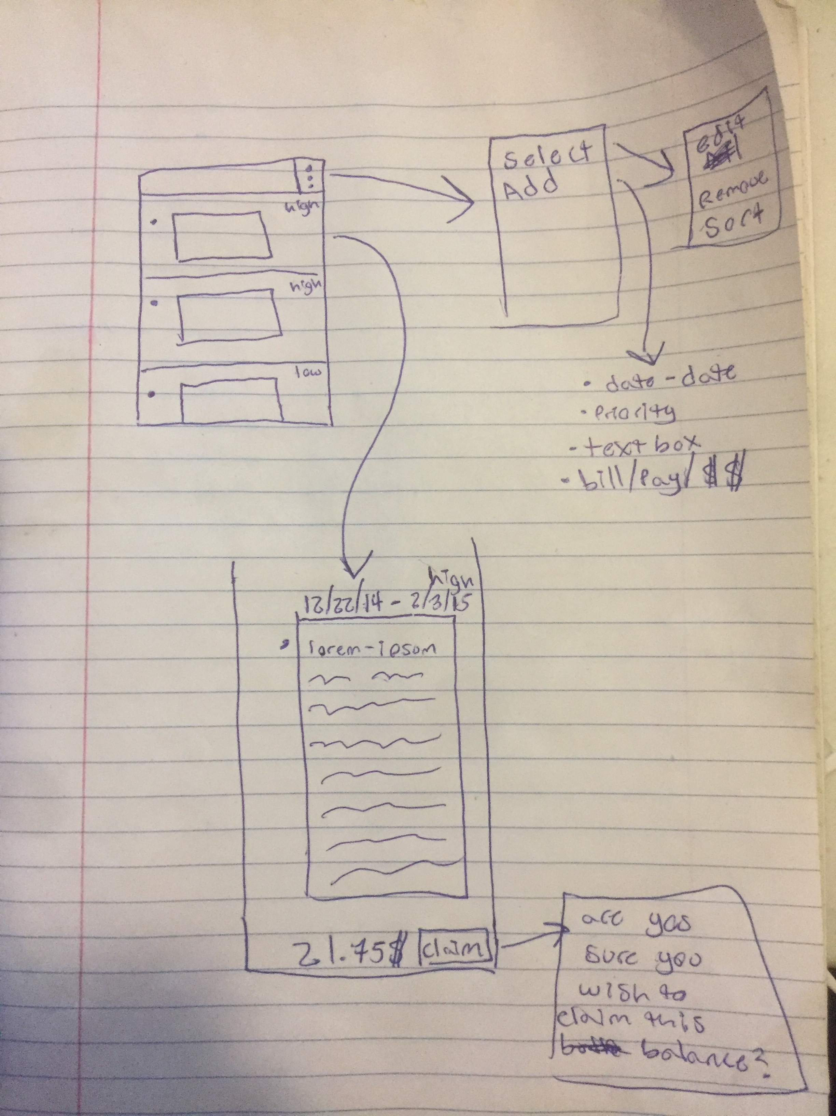
Project wireframe Schematic

Slide 5
Duties and Responsibilities
Duvall Pinkney – Slides show and Stack creation
Jahvon Smith – Main Activity and xml creation
Manual Ledesma- broadcast and receiver creation. Project was his idea.

Slide 6
Challenges
Coordinating the whole project via slack and on everybody’s different schedules proved to be too much.
Android is difficult during the short time we have to absorb the material then work feverishly to build an app.
Human resources became a last minutes issue due to classmates dropping. We started out at 5 and we are at least one person left.

Slide 7
Lessons Learned
Teamwork makes the dream work. If you start off with a team of people and you start losing members of your team projects take longer to work on. Especially when you lose team members who had the idea for the project in the first place.
Communication is key. Without it you have organized chaos. Everyone knows what he or she is doing except everybody else.

Slide 8
Clarity of Hindsight
The only thing anyone has control of is their own personal effort. You can not control other people, projects, or situations. Leadership is as important as team building. Delegation is good when you lack skills in an area where someone else excels in. Do not be afraid to ask for help.

Slide 9
Proud Accomplishments
Duvall - I for one learned that with software engineering that organization, teamwork, leadership, and Human Resources are the different keys to success in any one project. An individual can only get but so far by himself/herself. The human element is the key ingredient to success in any project. It is not just code or machine instructions plus just hours of labor and sleepless nights.

